Slide 1
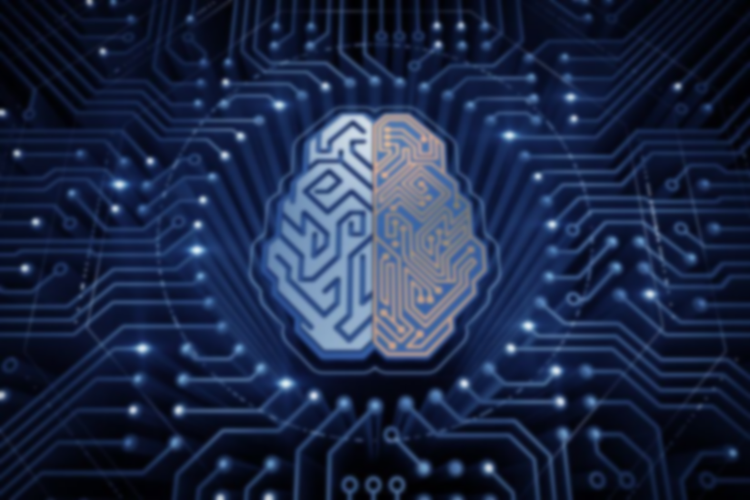
By: Ankit GUPTA
PREDICTING MOVIE SUCCESS USING MACHINE LEARNING TECHNIQUES

Slide 2

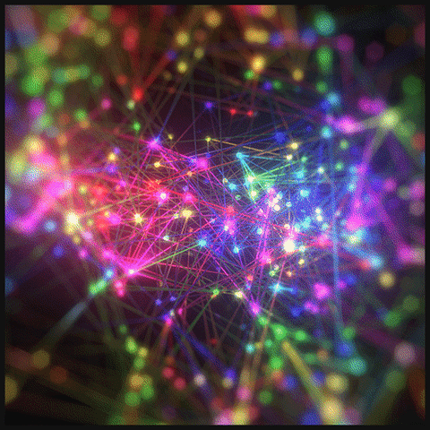
Introduction: MACHINE LEARNING
Learning is any process by which a system improves performance from experience.
Machine Learning is concerned with computer programs that automatically improve their performance through experience.
The core insight of machine learning is that much of what we recognize as intelligence hinges on probability rather than reason or logic.

Slide 3
INTRODUCTION
The worldwide Box ofﬁce revenue 2016 was 38.3 billion USD with hundreds of new movies made each year.
If one can use a computer to predict how successful a movie will be even before it is released, this would be a powerful tool to use. An aspiring Hollywood director or a movie studio with some technical skills could predict whether their movie idea is going to be a safe investment.
With the vast amount of data published on the Internet and the increasing power of the modern computer, is it possible to take advantage of these resources to make predictions ?

Slide 4
AND THIS IS HOW WE ENDED UP WITH THESE QUESTIONS:
Is it possible to use machine learning algorithms to predict if movie will receive a high or low rating?
Is the available data online viable for use in predicting movie success?
Is there a correlation between attributes and success of a movie?

Slide 5
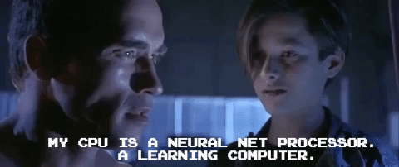
Machine learning: when ?
Machine Learning is useful when
Human expertise does not exist (navigating on Mars)
Humans are unable to explain their expertise (speech recognition)
Solution changes in time (routing on a computer network)
Solution needs to be adapted to particular cases (user biometrics)

Slide 6

CATEGORIES:

Slide 7
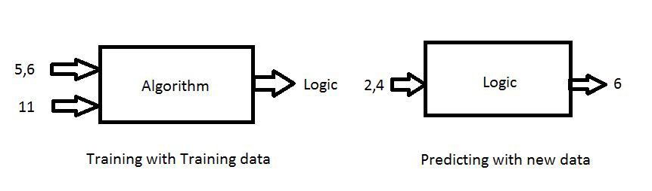
Supervised Learning
Machine learning takes data as input. lets call this data Training data.
The training data includes both Inputs and Labels(Targets)
Example : Addition of two numbers a=5, b=6 result =11, Inputs are 5,6 and Target is 11.

Slide 8
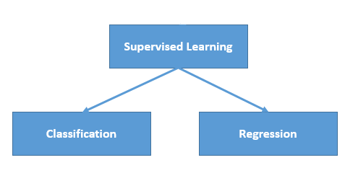
We first train the model with the lots of training data (inputs&targets) then with new data and the logic we got before we predict the output.
This process is called Supervised Learning which is really fast and accurate.

Slide 9
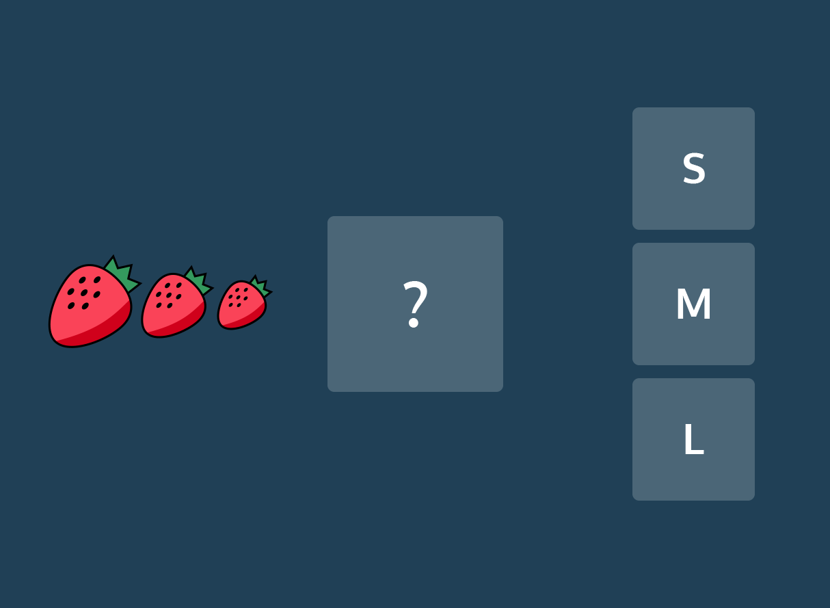
Classification
This is a type of problem where we predict the categorical response value where the data can be separated into specific “classes” (Ex: we predict one of the values in a set of values).
Some examples are
this mail is spam or not ?
will it rain today or not ?
is this picture a cat or not ?

Slide 10

Regression
This is a type of problem where we need to predict the continuous response value (Ex: we predict number which can vary from -infinity to +infinity)
Some examples are
what is the price of house in a specific city ?
what is the value of the stock ?
how many total runs can be on board in a cricket game ?

Slide 11

CLASSIFICATION SEPARATES THE DATA, REGRESSION FITS THE DATA

Slide 12
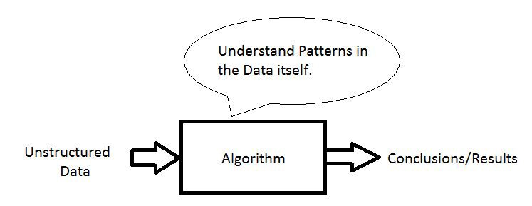
Unsupervised Learning
The training data does not include Targets here so we don’t tell the system where to go , the system has to understand itself from the data we give.
Here training data is not structured (contains noisy data, unknown data)

Slide 13
Clustering
This is a type of problem where we group similar things together.
Unsupervised learning is bit difficult to implement and its not used as widely as supervised.
Some examples are
given news articles, cluster into different types of news
given a set of tweets ,cluster based on content of tweet
given a set of images, cluster them into different objects

Slide 14
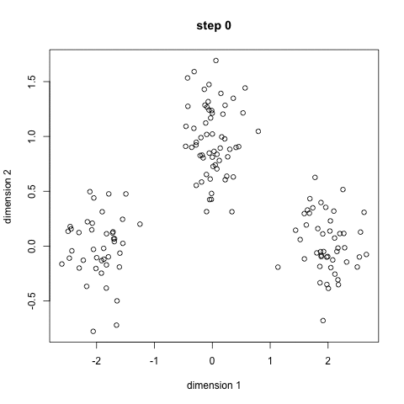

Examples
K-means:Partioning based
Density-Based Spatial Clustering

Slide 15
Reinforcement Learning
Reinforcement learning is the process of making the systems learn from the environment by itself.
There is a clear goal that the system needs to accomplish so the system has to complete the goal by applying the trail and error approach.
Supervised & Unsupervised → Learning from the data.
Reinforcement learning → Learning from the environment.

Slide 16
COMING TO OUR PROJECT : Objective
Given Data set of MOVIES, we have to predict whether the movie will be hit or flop. Further we will show the rating of the movie 0 being the lowest rating and 5 being the maximum rating.
Tags available are
Movie Name
Genre
Release Date
User ID
Movie ID
Rating

Slide 17
LITERATURE REVIEW
Muhammad Hassan Latif and Hammad Afzal. Prediction of movies popularity using machine learning techniques, 2016. http://paper.ijcsns.org/07_book/201608/20160820.pdf
V. Subramaniyaswamy. Predicting movie box office success using multiple regression and SVM. 7-8 Dec. 2017
https://ieeexplore.ieee.org/document/8389394
Javaria Ahmad. Movie success prediction using data mining. 3-5 July 2017
https://ieeexplore.ieee.org/document/8204173

Slide 18
Software used: Pycharm
PyCharm is an integrated development environment used in computer programming, specifically for the Python language. It is developed by the Czech company JetBrains.
Data set from: grouplens
URL: https://grouplens.org/datasets/movielens/
MovieLens Latest Datasets
We used education purpose dataset which contains
100,000 ratings and 3,600 tag applications applied to 9,000 movies by 600 users. Last updated 9/2018.

Slide 19
Libraries used:
Pandas
Pandas is a software library written for the Python programming language for data manipulation and analysis. In particular, it offers data structures and operations for manipulating numerical tables and time series.
Scikit Learn
Scikit-learn is a free software machine learning library for the Python programming language.It features various classification, regression and clustering algorithms including support vector machines, random forests, gradient boosting, k-means and DBSCAN, and is designed to interoperate with the Python numerical and scientific libraries NumPy and SciPy.
NumPy
NumPy is a library for the Python programming language, adding support for large, multi-dimensional arrays and matrices, along with a large collection of high-level mathematical functions to operate on these arrays.

Slide 20
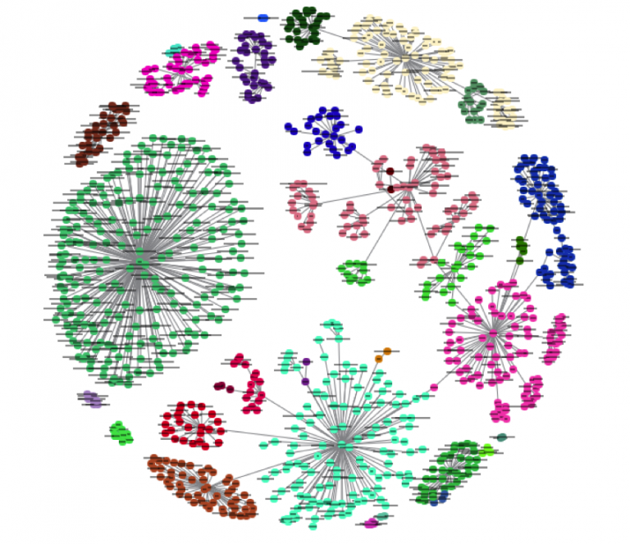
Method Used
The k-nearest neighbors (KNN) algorithm is a simple, easy-to-implement supervised machine learning algorithm that can be used to solve both classification and regression problems.
The KNN algorithm assumes that similar things exist in close proximity. In other words, similar things are near to each other.

Slide 21
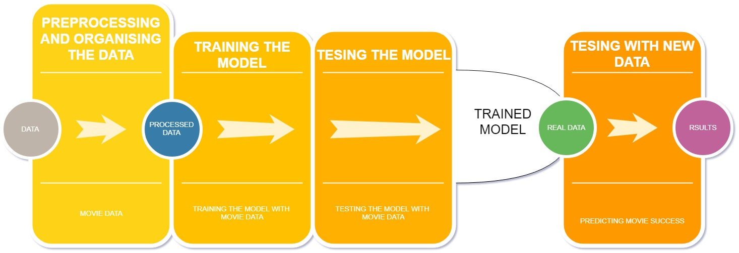
FLOW DIAGRAM

Slide 22
CONCLUSION
After building and testing our model using k-nearest neighbor method, we were able to predict movie success up to 70% accuracy.
So we can see that using Machine learning we were able to train the model quite effectively and able to predict the outcome of the movie.
To further improve we can give more tags and also include movie budget and money spent on advertisement to further improve our model.

Slide 23

Thank You

